Slide 1
Introduction to Neural Network Intelligence
Madeleine Bartlett

Slide 2
Contents
What is NNI?
Creating an experiment
Viewing results
Debugging

Slide 3

What is NNI?
Neural Network Intelligence
Toolkit - automate Feature Engineering, Neural Architecture Search, Hyperparameter Tuning and Model Compression
Supports a range of frameworks and libraries
Variety of search and optimization algorithms
Runs on Linux, macOS and Windows
Notes:
Neural network intelligence, or NNI, is a toolkit which allows users to automate a number of processes including hyperparameter tuning, which is what I’ll be focusing on

Slide 4


Creating an Experiment
Trial code = experiment.py
Code source: https://nni.readthedocs.io/en/latest/Tutorial/QuickStart.html
Notes:
There are 2 methods for using NNI to automatically train your model and find the best hyperparameters. One is to configure and launch the experiment from a python file. The other, which is the method I’ve used, is to write a config file and start the experiment from the command line
The first step in this approach is to modify the trial code.
The trial code is the piece of code where you define your hyperparameters and run the experiment
Only a couple of changes are needed for this piece of code
First, obviously, import nni
Replace any instructions to print or save your results, like the loss or whatever your success metric is with nni.report_result
Importantly, this metric needs to be in the form of an integer, float or numpy array
Importantly, replace the line where you set the parameters with nni.get_next_parameter()
This line, fairly self explanatory, is what changes the parameters on each trial

Slide 5
Creating an Experiment
Define the search space = example_config.yml
searchSpace:
batch_size:
_type: choice
_value: [16, 32, 64, 128]
hidden_size:
_type: choice
_value: [128, 256, 512, 1024]
lr:
_type: choice
_value: [0.0001, 0.001, 0.01, 0.1]
momentum:
_type: uniform
_value: [0, 1]
https://nni.readthedocs.io/en/latest/Tutorial/SearchSpaceSpec.html
Code source: https://nni.readthedocs.io/en/latest/Tutorial/QuickStart.html
Notes:
Next we define the search space in a YAML file
We need to set the name and the distribution of values to search through (this can be continuous or discrete)
The NNI website has a full list of the types of distributions you can use here
This can also be written as a JSON file instead
With each trial, nni draws values from these distributions to test

Slide 6
Creating an Experiment
Define the experiment = example_config.yml
experimentName: experiment # An optional name to distinguish the experiments
trialCommand: python3 experiment.py # NOTE: change "python3" to "python" if you are using Windows
trialConcurrency: 2 # Run 2 trials concurrently
maxTrialNumber: 10 # Generate at most 10 trials
maxExperimentDuration: 1h # Stop generating trials after 1 hour
tuner: # Configure the tuning algorithm
name: TPE
classArgs: # Algorithm specific arguments
optimize_mode: maximize
trainingService: # Configure the training platform
platform: local
https://nni.readthedocs.io/en/latest/builtin_tuner.html
https://nni.readthedocs.io/en/latest/reference/experiment_config.html#local-mode
Code source: https://nni.readthedocs.io/en/latest/Tutorial/QuickStart.html
Notes:
In the same file as the search space, in this case the YAML file, we also need to define or configure the experiment itself
There’s a whole bunch of things we can define here but the core things are:
Set the name of the file where the trial code is – in this case we named it experiment.py
trialConcurrency defines how many trials run at the same time
Max trial number and max duration dictate when the experiment will end. I’ll quickly just note that the experiment stops at the earliest opportunity. So if you’ve set max trials to 8000 but duration to 1h, it will stop after 1h even if only 5 trials have finished
You then need to pick the tuner, which defines how the search space is searched, and NNI has a bunch of options for this including Random Search, Grid Search
For most of these you also need to define the optimization mode which tells NNI which direction you want to search in – so do you want to maximize or minimize the output metric
There’s a whole range of ways you can configure the experiment and NNI provides some handy examples

Slide 7
Creating an Experiment
Run the experiment
nnictl create --config ~/config_experiment.yml
INFO: Starting restful server...
INFO: Successfully started Restful server!
INFO: Setting local config...
INFO: Successfully set local config!
INFO: Starting experiment...
INFO: Successfully started experiment!
-----------------------------------------------------------------------
The experiment id is egchD4qy
The Web UI urls are: [Your IP]:8080
-----------------------------------------------------------------------
Code source: https://nni.readthedocs.io/en/latest/Tutorial/QuickStart.html
Notes:
Once you’ve put these two files together you can run the experiment from the command line with this command
If the experiment starts running you’ll see the message: successfully started experiment!
You’ll also be shown the experiment ID which is also the ID under which the experiment log files will be saved – I’ll go into the log files in a bit
And you’ll see the url for the Web UI which is where you can go to watch the experiment’s progress

Slide 8
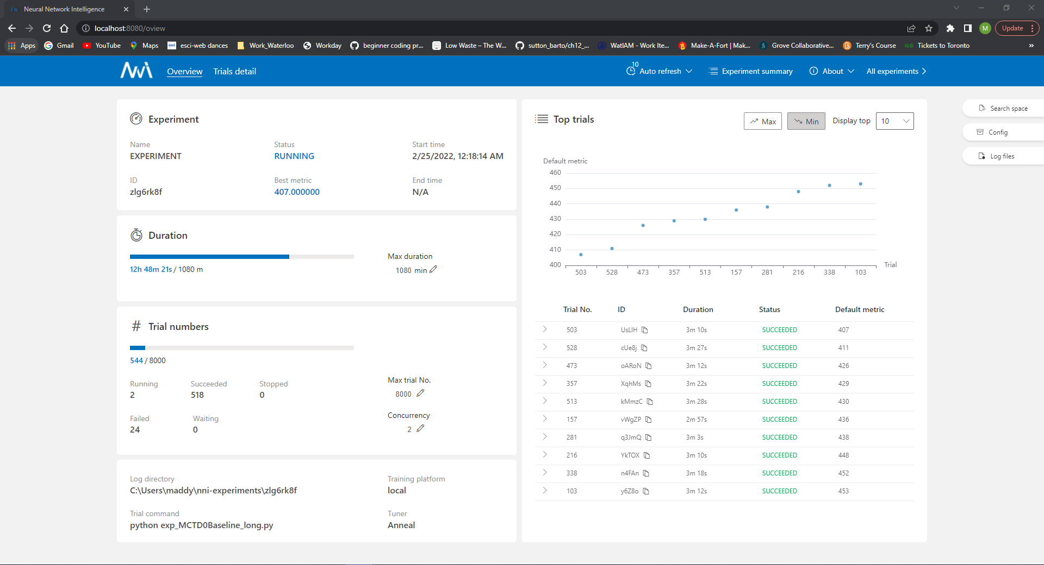
Notes:
So, this is the web UI for one of my experiments. But, to view the progress and results of the experiment you go to the url, in this case localhost 8080
This is the overview page where you can view the best metric found so far, the number of experiments that have failed or succeeded, and the amount of time left.
It also shows the address of the log directory, which will come in particular handy if you need to do some debugging. Which I’ll get to in a second.

Slide 9
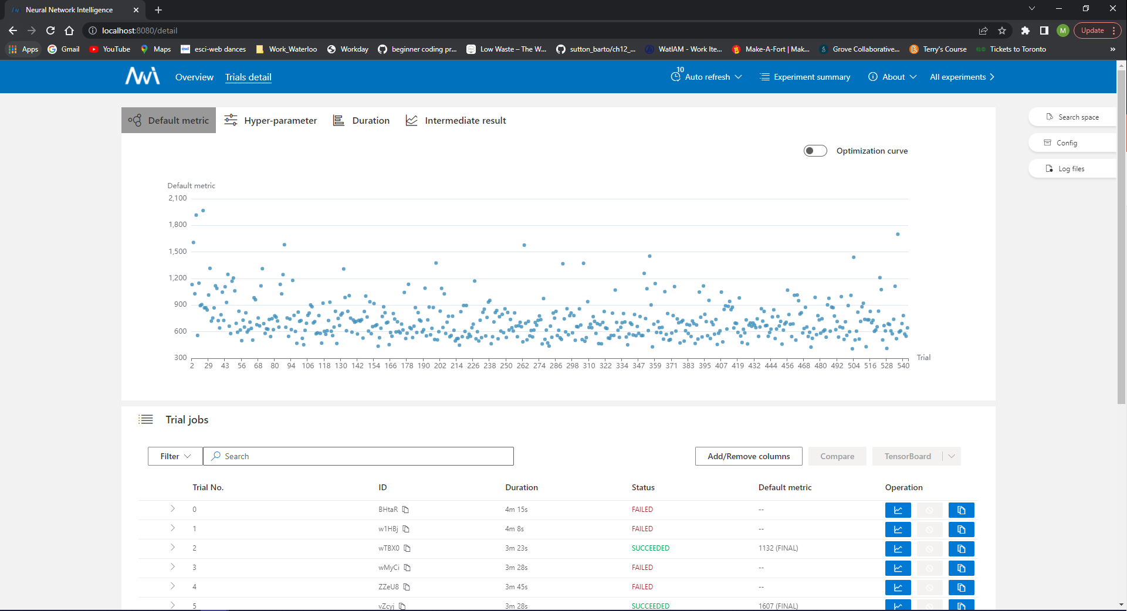
Notes:
For a more detailed look at the experiments you can go to the trials detail page and see the results from all the trials that have succeeded, a plot of the hyperparameter values that have been tested, plots of trial duration and the intermediate results if you requested those in your trial script.

Slide 10
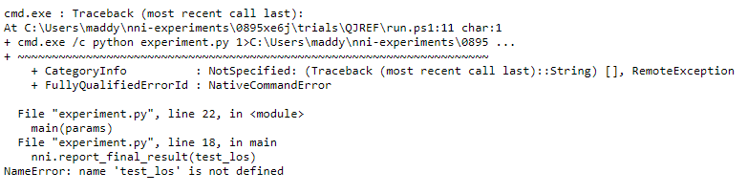
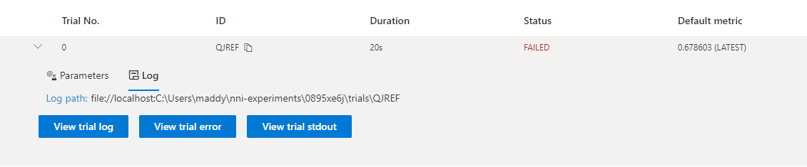

Debugging
View from the Web UI
Locate log files:
Default: C:\Users\USERNAME\nni-experiments
Navigate to trial folder
Open stderr file in a text-viewer (i.e. notepad) to view any error messages
Notes:
You can view the log files either from the Web UI or from the file directory
In the Web UI, if you want to view the errors from failed trials, navigate to the Trials detail tab and click the arrow next to the trial in question.
Clicking on the view trial error button opens another tab where you can view the error file
Alternatively you can access the files directly by navigating to the folder on your system and opening the stderr file in a text-viewer

Slide 11

Links and References
Thank you!
nnSpider emoticons: https://github.com/microsoft/nni/tree/v2.5/docs/img/emoicons
NNI website: https://nni.readthedocs.io/en/latest/index.html
NNI github: https://github.com/microsoft/nni/tree/master
Code examples were copied from NNI website
https://nni.readthedocs.io/en/latest/Tutorial/QuickStart.html

